Slide 1
AMAZON E-Commerce
By, Kishore B.G
From Newton School

Slide 2
About, Amazon -Over 300 million active customer accounts exist on Amazon globally. -Over 75% of shoppers check Amazon reviews before buying products online. -Amazon ships more than 1.6 million packages per day

Slide 3
Problem Statement:
You are working as a business analyst at Amazon, a company currently performing well. The stakeholders wish to maintain this level of performance and seek improvement. For this purpose, they want to devise new strategies. You are part of a team exploring new ways to benefit customers, such as offering more discounts and Prime membership perks. Could you suggest additional methods to identify and reward customers and enhance their shopping experience?

Slide 4
DATASET OVERVIEW
OrderDate: The date when the order was placed.
OrderID: A unique identifier for each order.
Delivery Date: The date when the order is scheduled to be delivered.
CustomerID: A unique identifier for each customer.
Customer Age: The age of the customer.
Customer Gender: The gender of the customer (M for male, F for female).
Location: The geographical area where the customer is located.
Zone: Specific zone within the location for delivery purposes.
Delivery Type: The method by which the order is delivered (e.g., Express, Standard).
Product Category: The broad category to which the product belongs.
SubCategory: A more specific classification within the product category.
Product: The name or description of the product ordered.
Unit Price: The price per unit of the product.
Shipping Fee: The fee charged for shipping the product.
Order Quantity: The quantity of the product ordered.
Sale Price: The total sale price of the order.
Status: Current status of the order (e.g., Delivered, Returned).
Reason: The reason for the return or an empty field if delivered.
Rating: Customer rating for the order on a scale (e.g., 1 to 5).

Slide 5
Dataset Cleaning Steps Understand the Dataset -Review column names, data types, and structure -Explore unique values, distributions, and record counts Identify key columns (IDs, dates, measures, categories) Remove Duplicates -Drop exact duplicate rows -Handle near-duplicates based on business logic (e.g., same email, different name) Handle Missing Values -Identify nulls or blanks using filters or functions -Remove rows/columns with excessive missing data -Impute values using mean, median, mode, or logic-based rules -Flag or categorize rows with missing values if needed Correct Data Types -Convert text to numeric, date to datetime, etc. -Ensure consistency across tables for joins/relationships -Clean Text Fields

Slide 6
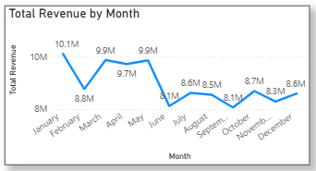
monthly sales trends
INSIGHTS:
The results showed that certain months—such as February and June—consistently underperformed in comparison to peak months like November and March. These low-sales months present an opportunity for strategic marketing.
To address this, the company could implement seasonal campaigns such as “Back to School” offers at June end or special monsoon deals in July. Additionally, flash sales, personalized email promotions based on purchase history, and referral incentives can help stimulate demand during these quieter periods.

Slide 7
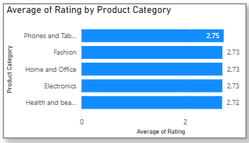
ratings of products impact their sales value?
INSIGHTS:
The visualization revealed a clear positive trend, indicating that products with higher customer ratings generally generate more revenue. Additionally, a bar chart is grouped by rating categories.
Here, it is observed that phones and tablets have the highest average rating, and this category produces the highest revenue.

Slide 8
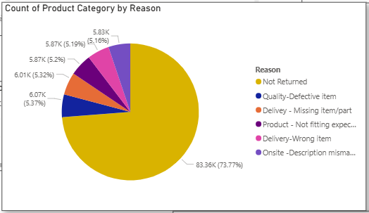
possible reasons for returns
INSIGHT:
It is also found that a quality defective item is one of the major reasons for the return, so we must focus on selling good quality products
Customer-driven reasons also play a significant role. Sometimes, buyers simply change their minds, find a better price elsewhere, or return gifts and duplicate items. These can be reduced through better pre-purchase information and competitive pricing strategies.

Slide 9
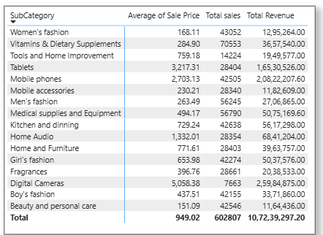
items WITH high prices yet underperform in sales
INSIGHTS:
We can view that digital cameras are the ones that are sold in low quantities. Even though they produce great revenue but the quantity sold is low.
Similarly, Tools and Home improvement have a high average sale price and a low no of quantities of products sold. Therefore, marketing is required for home improvement tools and digital cameras.

Slide 10
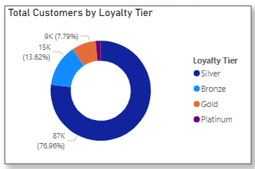
different loyalty tiers
INSIGHTS
Platinum: High spenders and frequent buyers
Gold: Moderate spenders and active buyers
Silver: Low spend/infrequent buyers
Bronze: Low spend/frequent buyers
Understanding these segments helps tailor marketing, promotions, and customer retention efforts effectively.
Customizing offers by segment ensures that each customer receives relevant promotions, improving response rates.

Slide 11
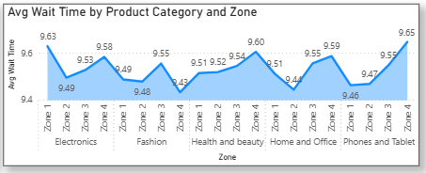
Wait Times Correlated with Demographics
INSIGHTS:
An Area chart was built to show the average wait time per product category, revealing that certain categories like “Fashion” and “Electronics” experience longer delivery durations, particularly when products are shipped from abroad.
These findings can inform better inventory distribution, regional warehousing, and staffing decisions, especially for high-demand categories with longer wait times.

Slide 12
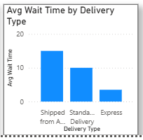
relationship between the Delivery type and waiting time
INSIGHTS:
It is observed that orders marked as “Shipped from Abroad” had substantially higher average wait times compared to local delivery types such as “Standard” or “Same Day.”
Businesses can use this insight to set more accurate delivery expectations, optimize supply chain operations, and potentially offer faster alternatives for frequently delayed delivery types.

Slide 13
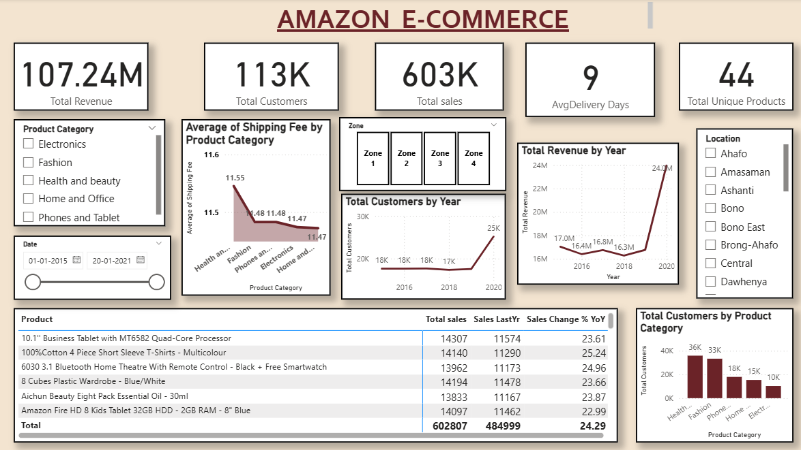
REPORT PAGE 1 (MAIN TAB)

Slide 14
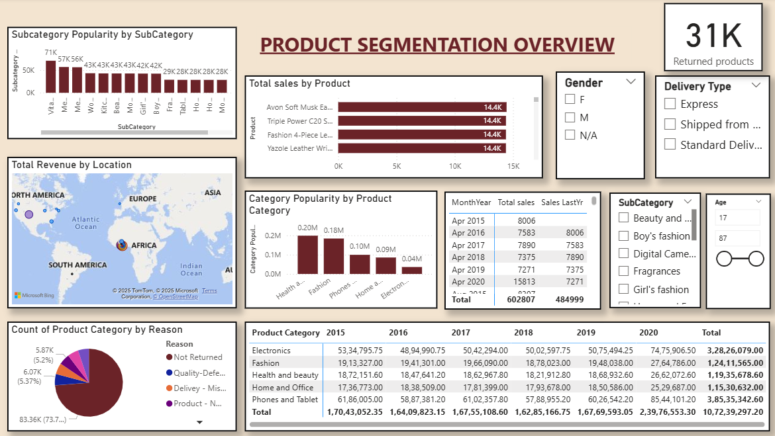
REPORT PAGE 2 (PRODUCT TAB)

Slide 15
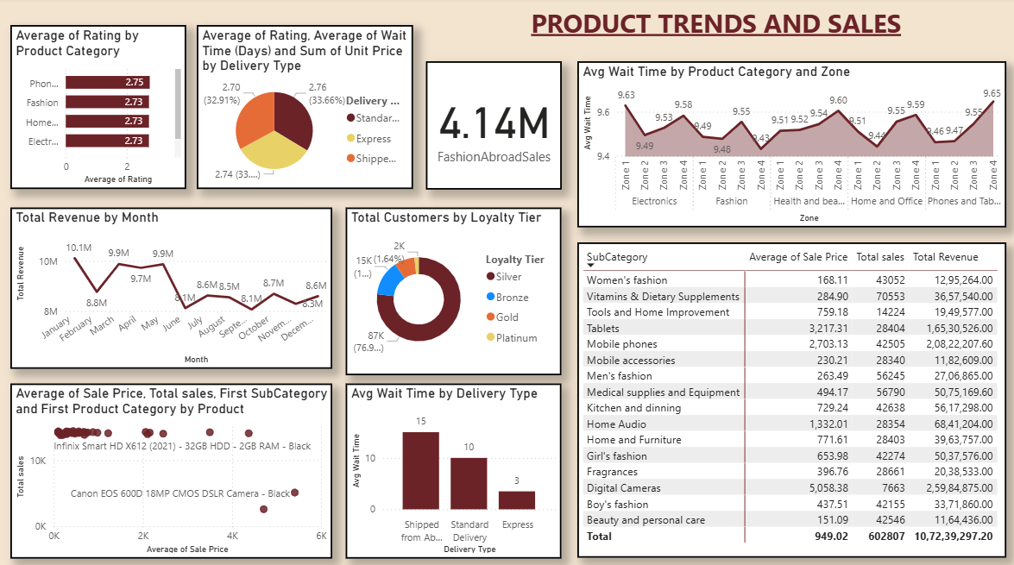
REPORT PAGE 3 (INDIVIDUAL PRODUCT TAB)

Slide 16
FINAL RECOMMENDATIONS
Customer Insights & Recommendations
Segment your customers into Platinum, Gold, Silver, and Bronze tiers based on spend and purchase frequency. ➤ Target Platinum and Gold with exclusive offers and loyalty programs to retain high-value customers.
Silver customers (low spend/infrequent) show low engagement. ➤ Use email reactivation campaigns and targeted discounts to re-engage them.
Bronze customers (low spend/frequent) often buy low-value items. ➤ Upsell related products or bundle items to increase average order value.
High return rates observed in specific customer segments. ➤ Investigate return reasons and improve communication, sizing guides, or product expectations.

Slide 17
FINAL RECOMMENDATIONS
Operational & Strategic Recommendations
Optimize logistics in areas with high return or late delivery issues. ➤ Switch to more reliable couriers or improve warehouse processing.
Use Power BI dashboards to track KPIs in real time: ➤ Sales trends, top products, customer segmentation, return rates, regional performance.
Monitor return reasons regularly to refine listings, quality, and sizing information.
Apply predictive analytics to forecast demand and reduce excess stock or shortages.
Sales peak during festive/seasonal months (e.g., Diwali, Black Friday, Year-end). ➤ Plan marketing campaigns and inventory stocking around these periods

Slide 18
THANK YOU
"E-commerce made easy, trust built daily."

